Slide 1


Information Security IA
SQL Injections using
SQL MAP
By:
16010120010 – Hetvi Gudka
16010120031 – Akhil Nagar
16010120039 – Abdemanaf Poonawala

Slide 2

SQL injection is a technique used to exploit user data through web page inputs by injecting SQL commands as statements. Basically, these statements can be used to manipulate the application’s web server by malicious users.
SQL injection is a code injection technique that might destroy your database.
SQL injection is one of the most common web hacking techniques.
SQL injection is the placement of malicious code in SQL statements, via web page input.
Eg: SELECT * from STUDENT where STUDENT-ID == 12222345 or 1 = 1
Now this 1=1 will return all records for which this holds true. So basically, all the student data is compromised. Now the malicious user can also delete the student records in a similar fashion.

Slide 3
Sqlmap is an open source penetration testing tool that automates the process of detecting and exploiting SQL injection flaws and taking over of database servers. It comes with a powerful detection engine, many niche features for the ultimate penetration tester and a broad range of switches lasting from database fingerprinting, over data fetching from the database, to accessing the underlying file system and executing commands on the operating system via out-of-band connections.

Slide 4

Full support for MySQL, Oracle, PostgreSQL, Microsoft SQL Server, Microsoft Access, IBM DB2, SQLite, Firebird, Sybase, SAP MaxDB, Informix, MariaDB, MemSQL, TiDB, CockroachDB, HSQLDB, H2, MonetDB, Apache Derby, Amazon Redshift, Vertica, Mckoi, Presto, Altibase, MimerSQL, CrateDB, Greenplum, Drizzle, Apache Ignite, Cubrid, InterSystems Cache, IRIS, eXtremeDB, FrontBase, Raima Database Manager, YugabyteDB, ClickHouse and Virtuoso database management systems.
Full support for six SQL injection techniques: boolean-based blind, time-based blind, error-based, UNION query-based, stacked queries and out-of-band.
Support to directly connect to the database without passing via a SQL injection, by providing DBMS credentials, IP address, port and database name.
Support to enumerate users, password hashes, privileges, roles, databases, tables and columns.
Automatic recognition of password hash formats and support for cracking them using a dictionary-based attack.

Slide 5
Support to dump database tables entirely, a range of entries or specific columns as per user's choice. The user can also choose to dump only a range of characters from each column's entry.
Support to search for specific database names, specific tables across all databases or specific columns across all databases' tables. This is useful, for instance, to identify tables containing custom application credentials where relevant columns' names contain string like name and pass.
Support to download and upload any file from the database server underlying file system when the database software is MySQL, PostgreSQL or Microsoft SQL Server.
Support to execute arbitrary commands and retrieve their standard output on the database server underlying operating system when the database software is MySQL, PostgreSQL or Microsoft SQL Server.
Support to establish an out-of-band stateful TCP connection between the attacker machine and the database server underlying operating system. This channel can be an interactive command prompt, a Meterpreter session or a graphical user interface (VNC) session as per user's choice.
Support for database process' user privilege escalation via Metasploit's Meterpreter getsystem command.

Slide 6

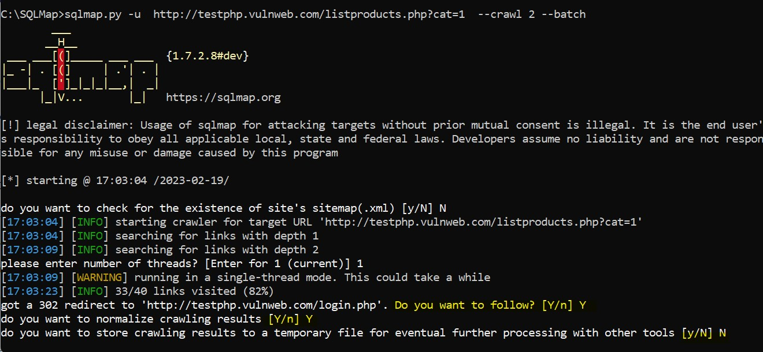
Batch

Slide 7
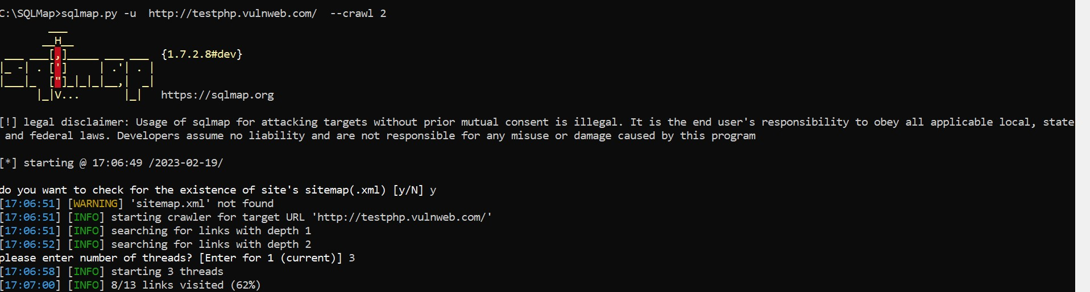
Crawl

Slide 8
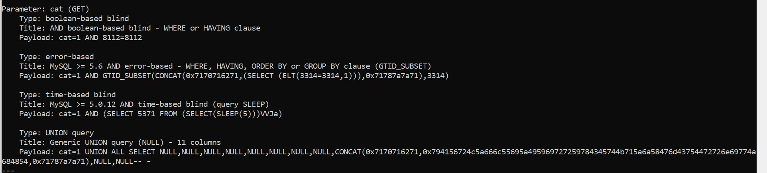
Crawl output

Slide 9
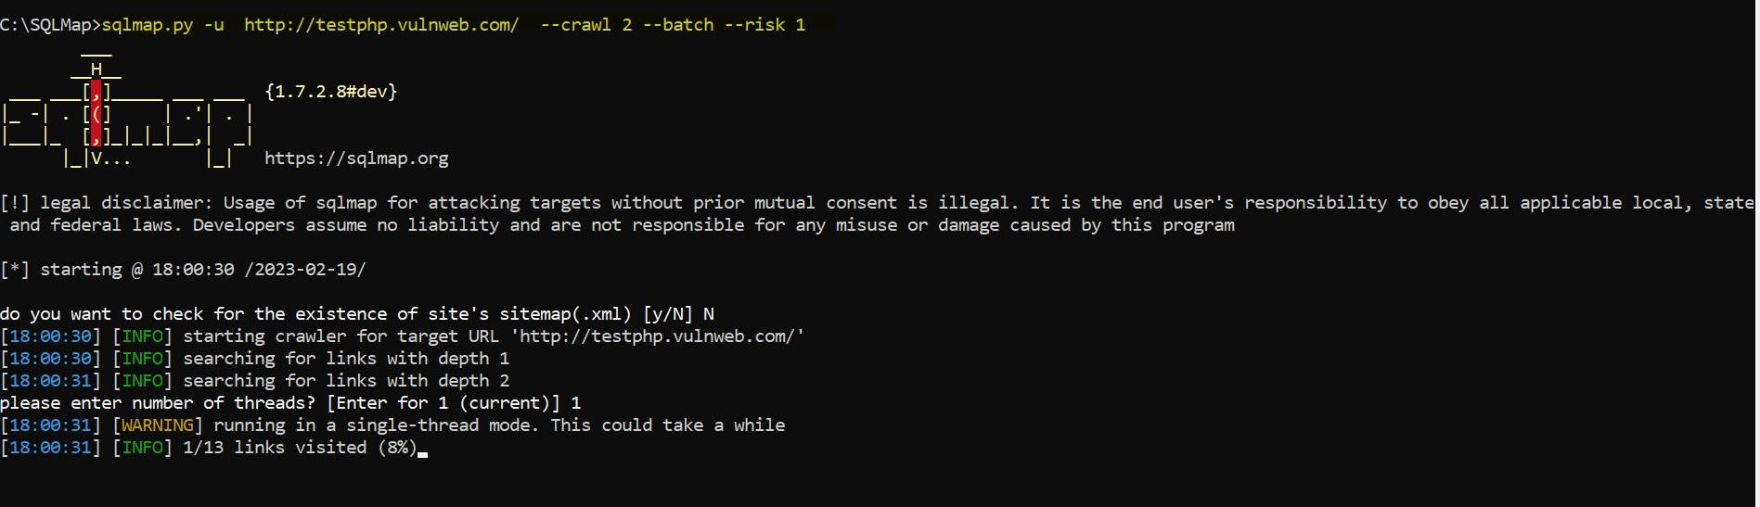
Risk

Slide 10
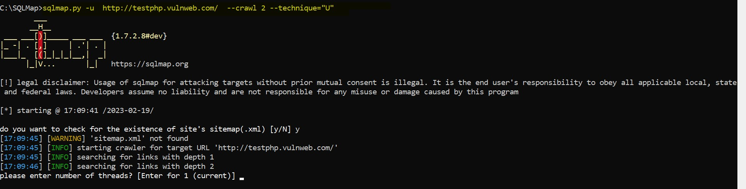
Technique

Slide 11
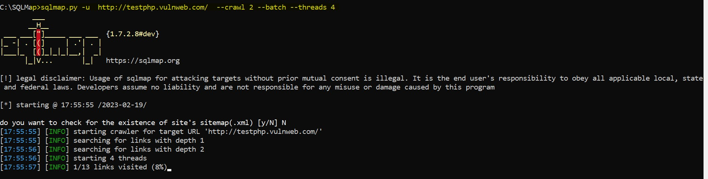
Threads

Slide 12
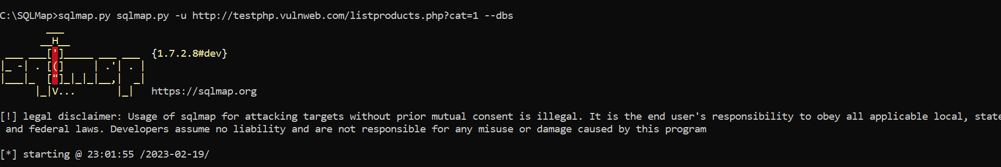
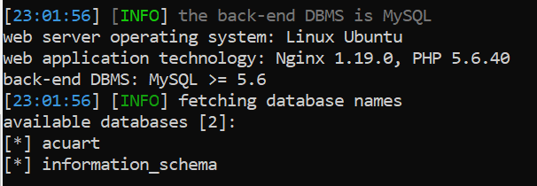
Dbs

Slide 13
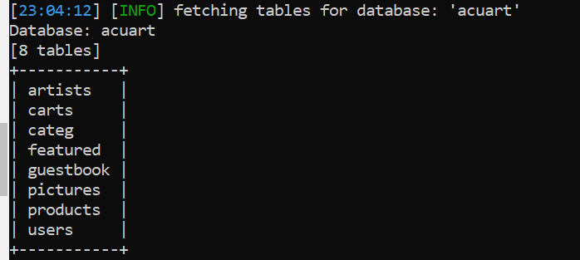
Tables

Slide 14
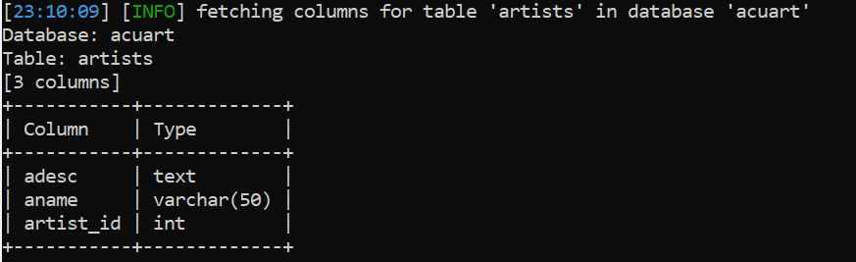
Columns of Tables

